Slide 1
Secure Text Messenger
An application for simple, yet secure, text communication
Written by James Williamson & Rui Wang

Slide 2
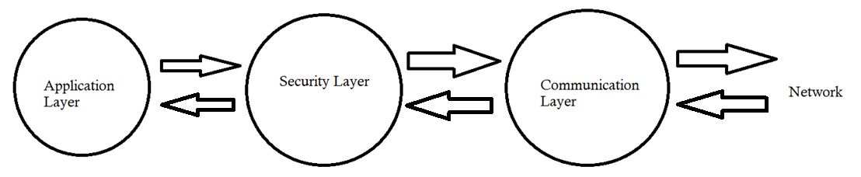
Architectural Design
Designed for simplicity and reliability
Ease of Use through GUI

Slide 3
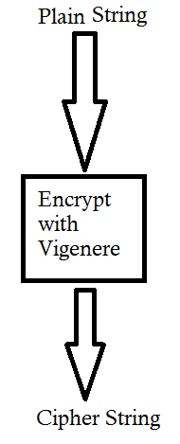
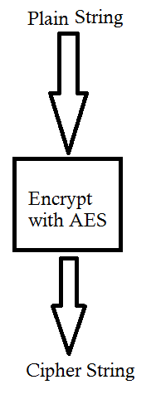
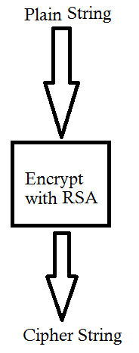
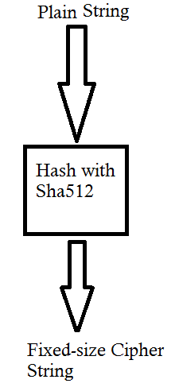
Security Layer
Holds private members for key Values that are initialized when application is run
Each function is a black box for string encryption/decryption

Slide 4
Performance Check
Algorithm | Encryption time per 1000 | Decryption Time per 1000
Symmetric (Vigenere) | 14 | 23
Symmetric (AES 256) | 60 | 15
RSA2048 | 77 | 4863
Confidentiality
Algorithm | Time per 1000 | Verification time per 1000
Sha512 Hash | 13 | <1
RSA2048 Signature | 4857 | 76
MAC (MD5) | 15 | <1
Integrity and
Authenticity
*All fields in Milliseconds

